Slide 1
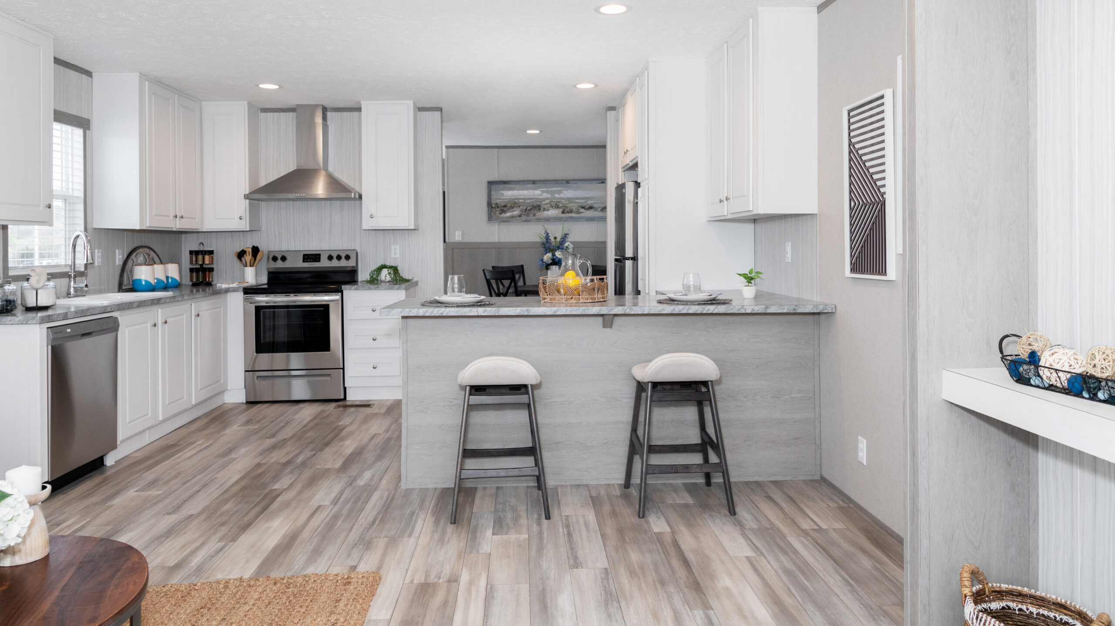
2023 B2B SURVEY RESULTS
CLAYTON-MAYNARDVILLE
BLAZER 76F
Featuring: Shining Star Decor

Slide 2
2023 SURVEY HIGHLIGHTS
Participation Rate
85%
NPS
89.33
Ease of Doing Business
77%

Slide 3
TOP 3 AREAS OF FOCUS FOR 2024
Clear & consistent communication with our partners
Ensuring top quality homes and products to our customers
Providing more valuable & transparent communication concerning service & parts

Slide 4
CLEAR & CONSISTANT COMMUNICATION
Staying Focused
Pre-Planning
Important Product Changes
Reminders of Upcoming Events
Weekly Update Emails
Monthly Update Emails
Increasing Visibility of Orders
Updating Offline Dates Immediately
Correspondence to Partners regarding Offline Changes

Slide 5
ENHANCINGTHE QUALITYOF OUR HOMES
Implementing the new Q360 program
Created Process Improvement Coordinator position to better aid both QA & Production Teams
Researching different & new door options with built in storm doors
Trying out new floor cleaners to maintain cleanliness with safety when cleaning the linoleum and limiting the fall hazard

Slide 6
PROVIDING VALUABLE & TRANSPARENT COMMUNICATION WITH SERVICE & PARTS
SERVICE
Hiring at least 1 additional Service Technician
PARTS
Parts runner availability twice a month
CUSTOMER
Transparency when service work is to be performed
Conduct better training between Retail Centers & Service Technicians
Availability to see service schedule and upcoming work orders
Utilizing service techs to help deliver parts when available
Emails and Phone Calls updating Parts Orders statuses as they are available
Transparency when parts orders are being sent out
More communication during the scheduling & ordering process.

Slide 7
THANK YOU
We want to express our sincere gratitude for taking the time to participate in our survey. Your valuable insights contribute significantly to our ongoing efforts to improve & enhance our services.
Your feedback is instrumental in shaping our future initiatives. We look forward to continuing our wonderful partnership in 2024!

